Slide 1
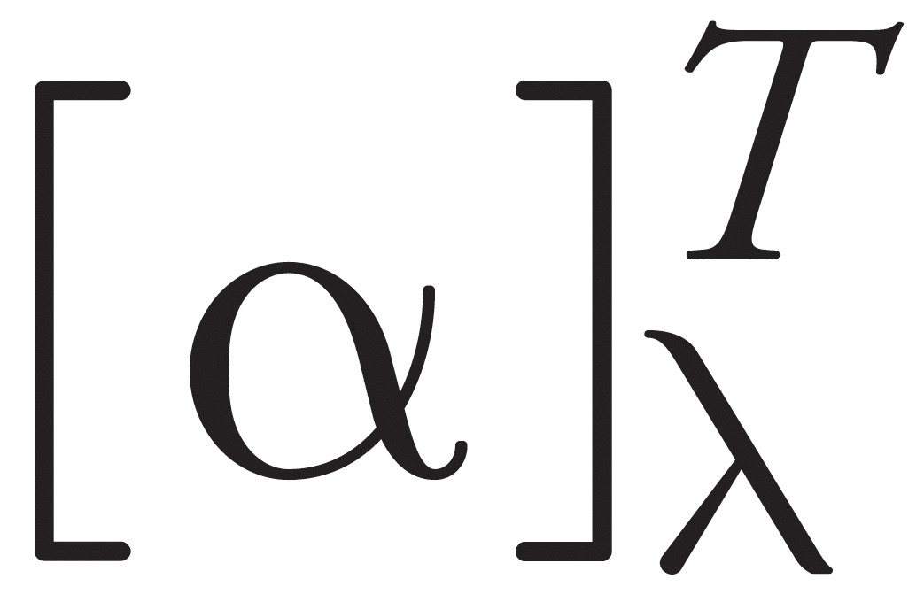
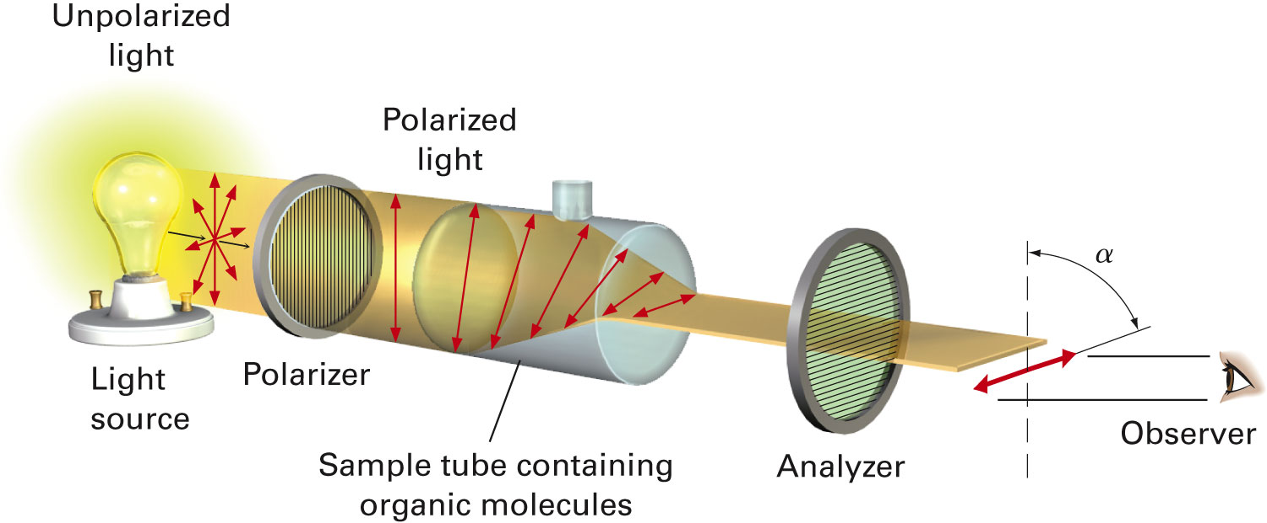
Optical Activity
Solutions of chiral compounds rotate plane-polarized light and the molecules are said to be optically active.
The angle between the entrance and exit planes is the optical rotation.
Rotation, in degrees, is [α]
Clockwise rotation is called dextrorotatory; Anti-clockwise is levorotatory
Depends on polarimeter pathlength (l) and sample concentration (c)
Temperature and the wavelength of light can also affect rotation and must be reported with measurements that are taken.

Slide 2
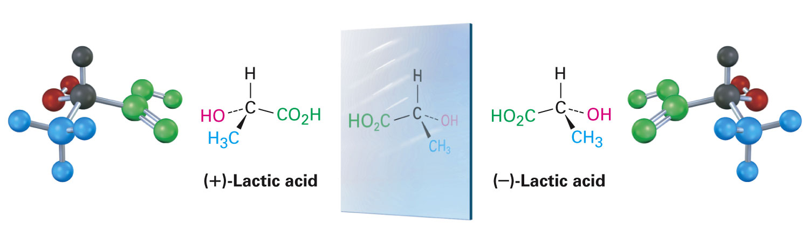
Optical Activity
To have a basis for comparison, define specific rotation, [α]_{D} for an optically active compound.
[α]_{D} = observed rotation/(pathlength x concentration) = α /(l x C) = degrees/(dm x g/mL)
Specific rotation is that observed for 1 g/mL in solution in cell with a 1 dm (10 cm) path using light from sodium metal vapor (589 nm).
The specific rotation of the enantiomer is equal in magnitude but opposite in sign.
A sample containing equal amounts of both enantiomers will have a zero specific rotation. Such mixtures are called “racemic mixture”.
[α]_{D} of +3.82
[α]_{D} of -3.82

Slide 3
Enantiomeric Excess
A sample of an optically active substance that consists of a single enantiomer is said to be enantiomerically pure or to have an enantiomeric excess of 100%
An enantiomerically pure sample of (S)-(+)-2-butanol shows a specific rotation of +13.52
A sample of (S)-(+)-2-butanol that contains less than an equimolar amount of (R)-(–)-2-butanol will show a specific rotation that is less than 13.52 but greater than zero
Calculating Enantiomeric Excess (ee) or Optical Purity

Slide 4
Enantiomeric Excess from Optical Rotation
Enantiomeric Excess can also be calculated from the optical rotation data of a sample.
Example
A mixture of the 2-butanol enantiomers showed a specific rotation of +6.76º
The specific rotation of pure (S)-2-butanol is +13.5º
The enantiomeric excess of the (S)-(+)-2-butanol is 50%

Slide 5
What Does Enantiomeric Excess Mean?
It is important to know what this implies about the amounts of the enantiomers present in the sample. Since any R impurity will ‘cancel’ the rotation of an equal amount of S:
A sample with an ee of 50% (S) is actually 50% pure S and 50% racemic R/S.
The total S enantiomer in the sample is actually 75%!

Slide 6
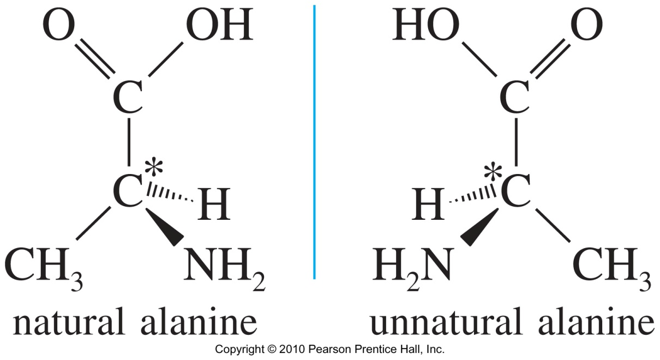
Specifying Absolute Configuration: R/S Nomenclature
Different molecules (enantiomers) must have different names.
Configuration around the chiral carbon is specified with (R) and (S).
The configuration is specified by the relative positions of all the groups with respect to each other at the chirality center
The groups are ranked in an established priority sequence and compared
The relationship of the groups in priority order in space determines the label applied to the configuration, according to a rule.

Slide 7
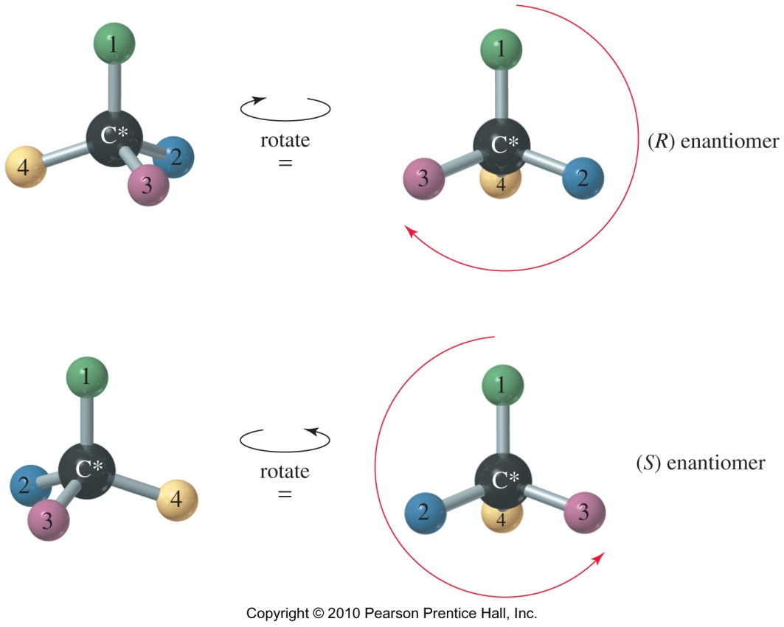
Sequence Rule/CIP (Cahn-Ingold-Prelog) Rule
Assign a priority number to each group attached to the chiral carbon.
Priority is assigned according to atomic number. The highest atomic number assigned is the highest priority #1.
In case of ties, look at the next atoms along the chain.
Double and triple bonds are treated like bonds to duplicate atoms.
Working in 3-D, rotate the molecule so that the lowest priority group is in back.
Draw an arrow from highest to lowest priority group.
Clockwise = (R), Counterclockwise = (S)

Slide 8
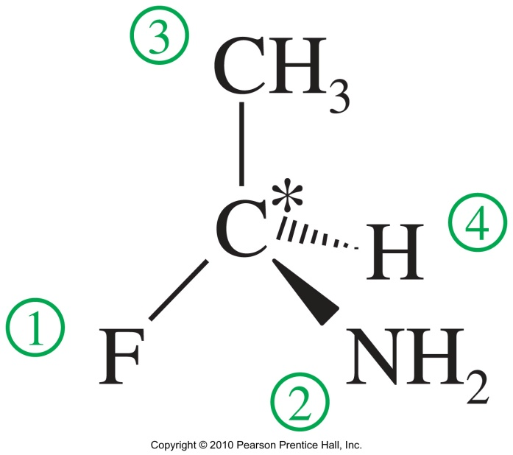
R/S Notation: Example
Atomic number: F > N > C > H
Assign Priority.
Rotate molecule such that lowest priority group is in the back (not required for this example).
Counterclockwise
(S)
Draw an arrow from Group 1 to Group 2 to Group 3 and back to Group 1. Ignore Group 4.
Clockwise = (R) and Counterclockwise = (S)

Slide 9
CAUTION!
If two different compounds have the same R (or S) configuration, it DOES NOT mean that they rotate the plane polarized light in the same direction!

Slide 10
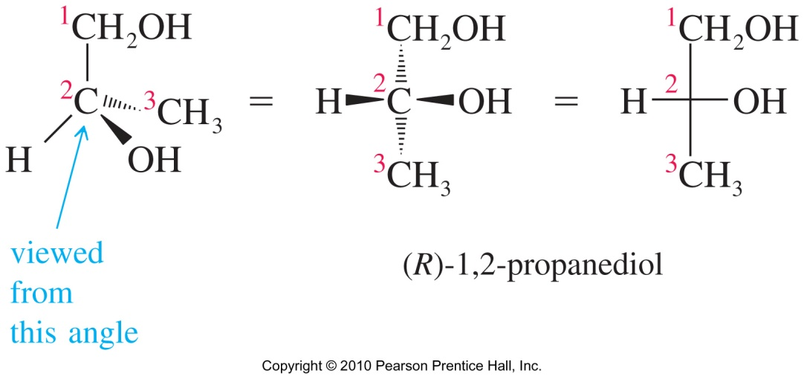
Fisher Projections
Flat representation of a 3-D molecule.
A chiral carbon is at the intersection of horizontal and vertical lines.
Horizontal lines are forward, out-of-plane.
Vertical lines are behind the plane.

Slide 11
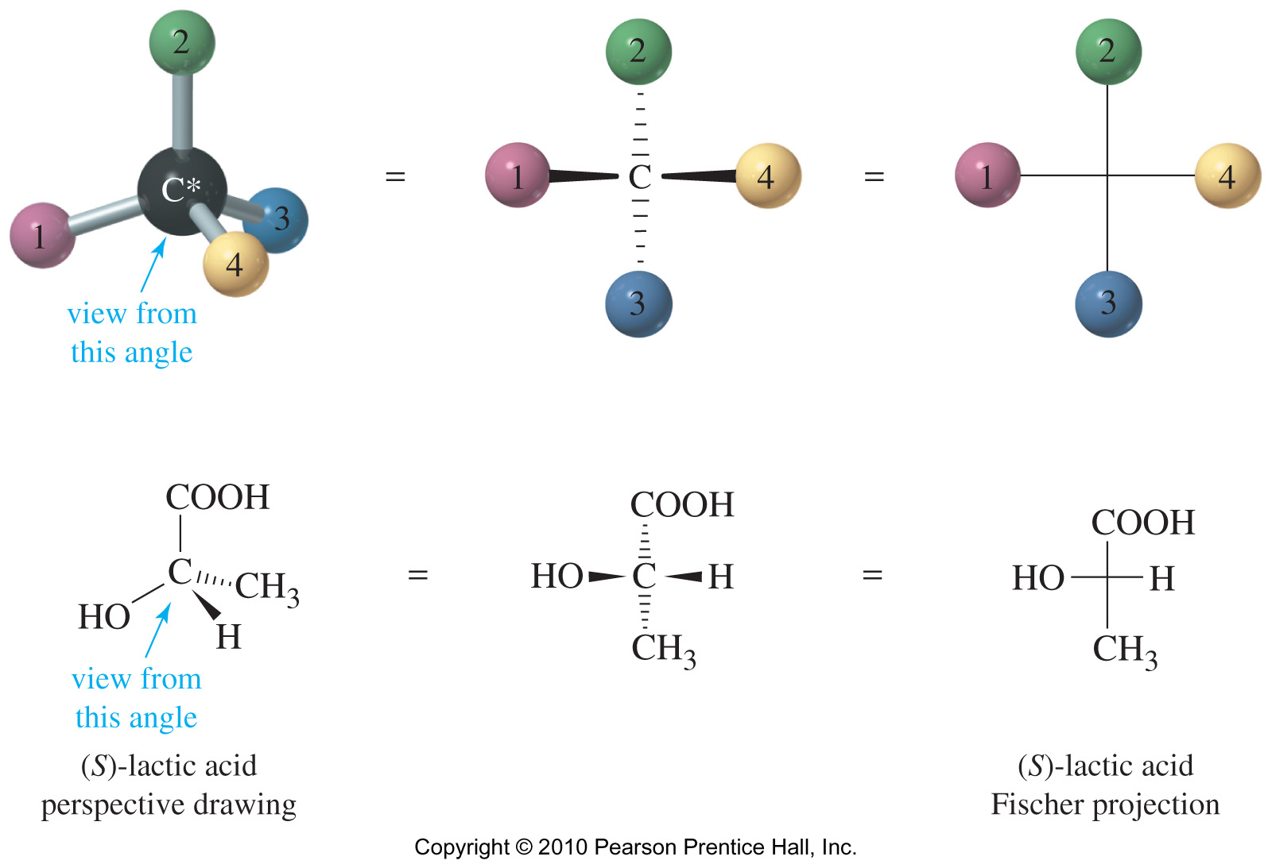
Fisher Projections
Apply CIP rules to assign priority to substituents.
If the lowest priority group is on the vertical line, clockwise 1 2 3 would be R configuration. If lowest priority group is on the horizontal line, the configuration will be “S”.

Slide 12
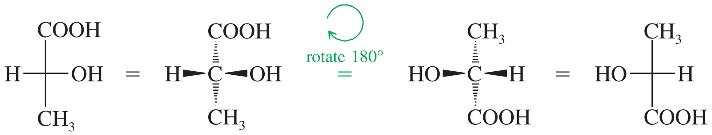
Maneuvering Fisher Projections: 180° Rotation
A rotation of 180° is allowed because it will not change the configuration.

Slide 13
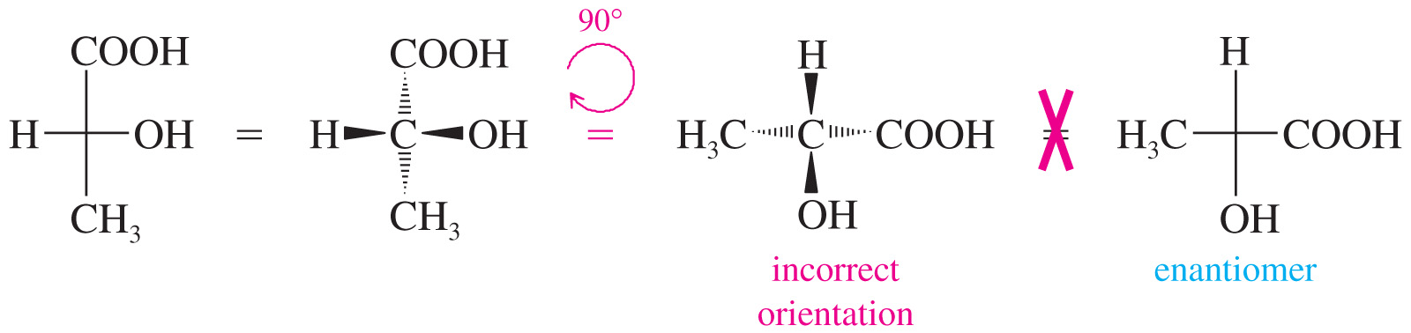
Maneuvering Fisher Projections: 90° Rotation
A 90° rotation will change the orientation of the horizontal and vertical groups.
Do not rotate a Fischer projection 90°.

Slide 14
Maneuvering Fisher Projections
If one group of a Fischer projection is held steady, the other three groups can be rotated clockwise or counterclockwise.

Slide 15
Molecules With More than One Stereocenter
When compounds have two or more chiral centers they have enantiomers, diastereomers, or meso isomers. Maximum number of isomers is 2^{n}, where n = the number of chiral carbons.
Enantiomers have opposite configurations at each corresponding chiral carbon.
Diastereomers have some matching, some opposite configurations. (In other words, if at least one center remains the same and at least one other flips, they are diastereomers!)

Slide 16
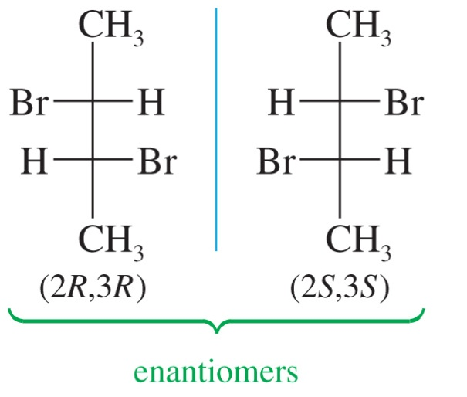
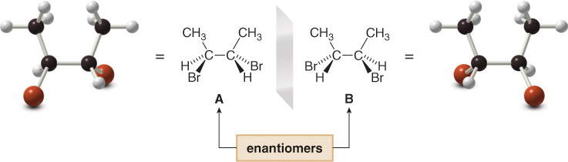
2,3-Dibromobutane
The 2^{n} rule will not apply to compounds that may have a plane of symmetry. 2,3-dibromobutane has only 3 stereoisomers.
# Stereocenters | # Stereoisomers | Stereoisomers
1 | 2 | R S
2 | 4 | (R,R) (S,S) (R,S) (S,R)
B
A

Slide 17
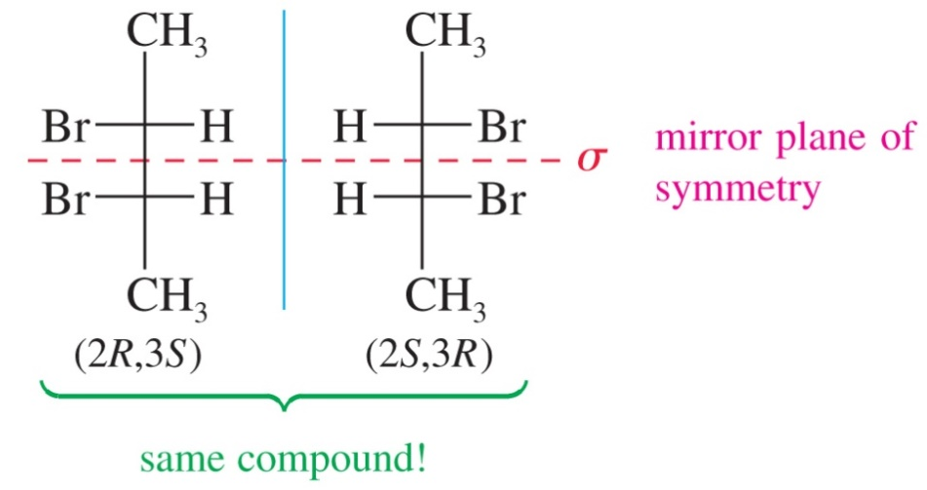
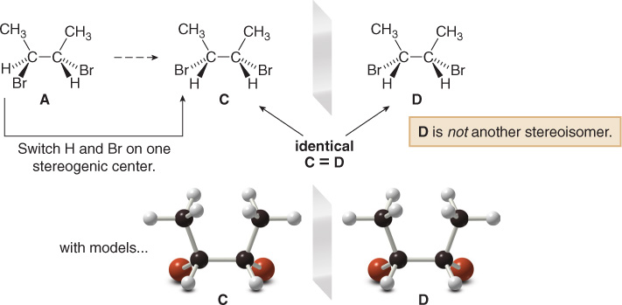
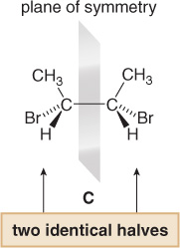
2,3-Dibromobutane: Meso Diastereomer
Meso compounds have a plane of symmetry.
If one image was rotated 180°, then it could be superimposed on the other image.
Meso compounds are achiral even though they have chiral centers.
S
R
S
S

Slide 18
2,3-Pentanediol
A and B are enantiomers
C and D are enantiomers
A and C, A and D, B and C, B and D are diastereomers

Slide 19
Racemic Mixtures and the Resolution of Enantiomers
A 50:50 mixture of two chiral compounds that are mirror images does not rotate light – called a racemic mixture.
The pure compounds need to be separated or resolved from the mixture (called a racemate)
To separate components of a racemate we make a derivative of each with a chiral substance that is free of its enantiomer (resolving agent)
This gives diastereomers that are separated by their differing solubility (or any other property)
The resolving agent is then removed

Slide 20
Properties of Enantiomers ad Diastereomers
Enantiomers:
Same boiling point, melting point, and density.
Same refractive index.
Rotate the plane of polarized light in the same magnitude, but in opposite directions.
Different interaction with other chiral molecules:
Active site of enzymes is selective for a specific enantiomer.
Diastereomers:
Have different physical and chemical properties. The difference may be significant.
Can be easily separated using various techniques.

Slide 21
Resolution of Enantiomers
C(+)
pure
Enantiomers, racemic
C(+)
C(-)
P(+)
Add pure
enantiomer
C(+)P(+)
2P(+)
C(-)P(+)
C(+)P(+)
C(-)P(+)
P(+)
Separate the diastereomers
C(-)
pure
Notes:
11

Slide 22
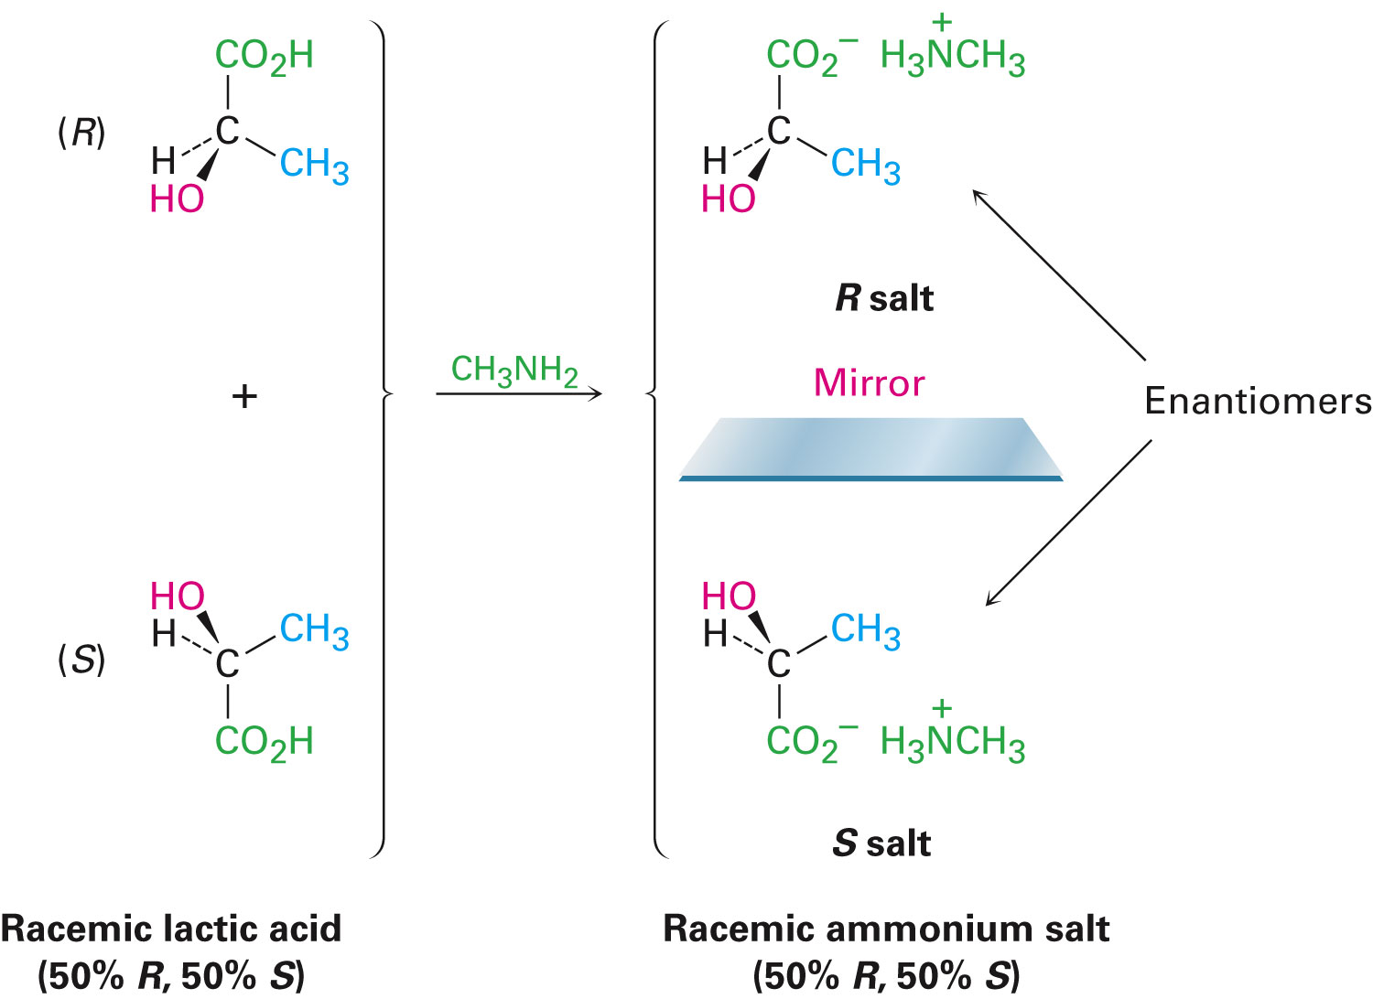
Resolution of Enantiomers: Requirement of a
Chiral Resolving Agent

Slide 23
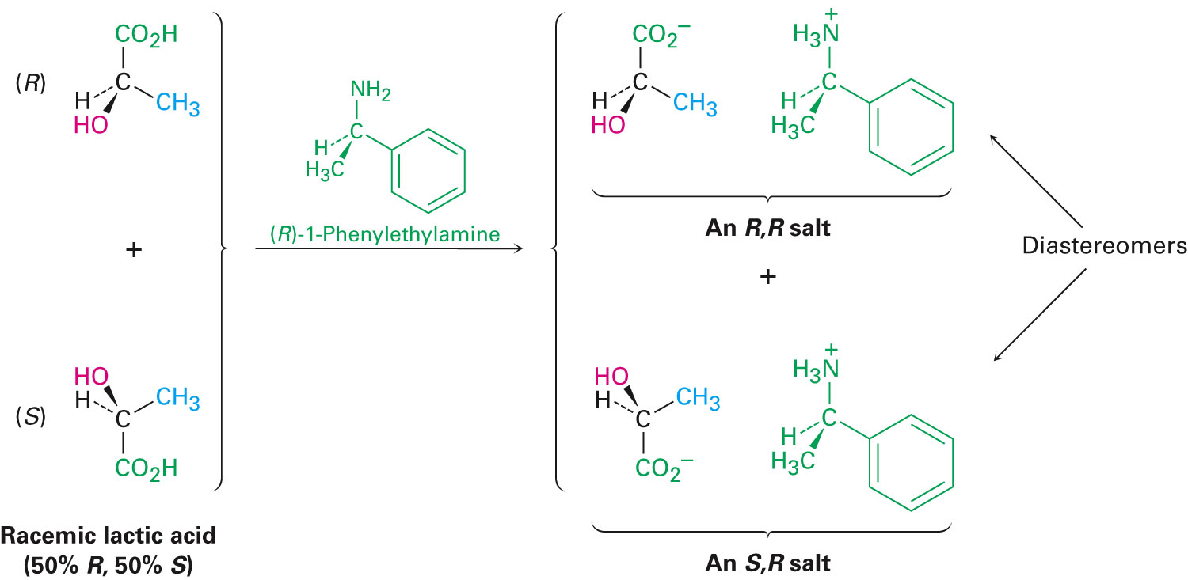
Resolution of Enantiomers: Requirement of a
Chiral Resolving Agent

Slide 24
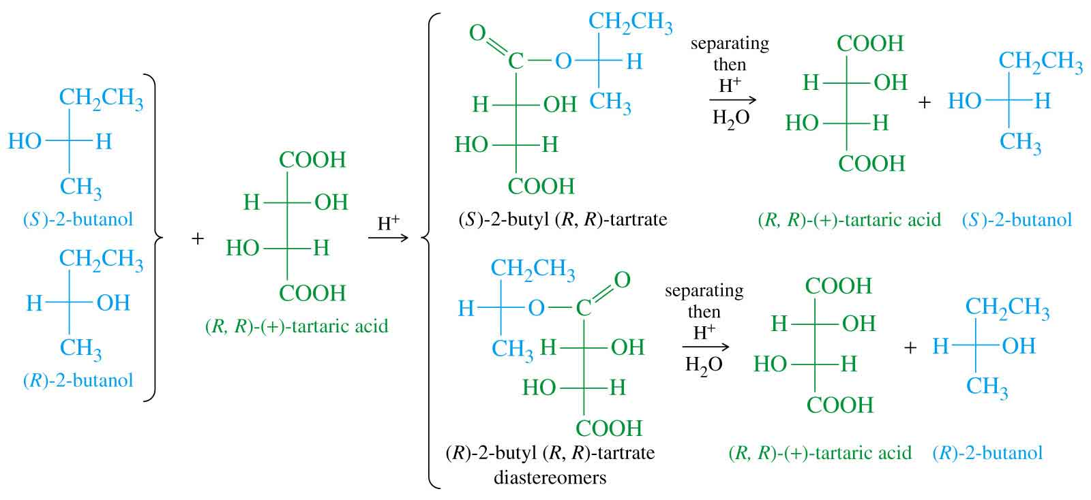
Resolution of Enantiomers
Covalent modifications can also be applied as long as there is a way to remove the resolving agent after the separation of diastereomers.

Slide 25
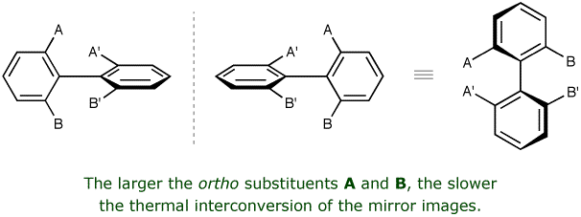
Chirality Without a Stereogenic Carbon Atom
Atropisomerism:
Atropisomers are stereoisomers resulting from hindered rotation about single bonds where the steric strain barrier to rotation is high enough to allow for the isolation of the conformers (from Greek, a = not and tropos = turn).
Observed in substituted biphenyl derivatives.
If the ortho substituents are large then the total strain restricts C-C bond rotation to such an extent that the two conformers become configurationally stable.

Slide 26
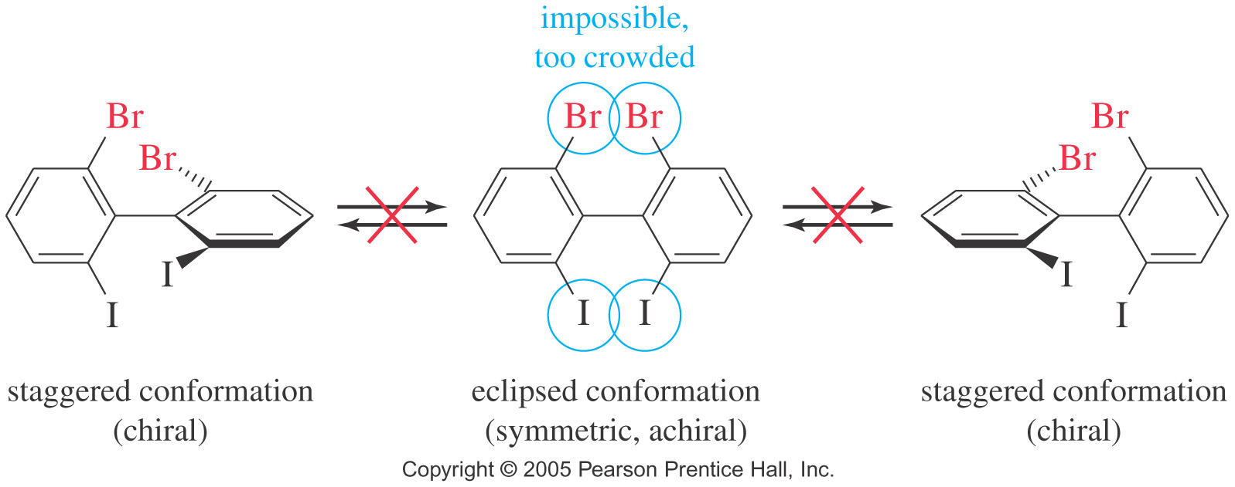
Atropisomerism
First observed in 1922 by Cristie. The term “atropisomerism” was coined in 1933.
This type of chirality is termed “Axial Chirality” because it involves the spatial arrangements of substituents along as axis such that the molecule is non-superimposable on its mirror image.

Slide 27
Atropisomerism
Barrier to rotation determines the half life of the conformers.
In general, atropisomers are considered physically separable when they have a half-life at room temperature of >1000 s (16.7 min).

Slide 28
Nomenclature System
On every phenyl ring, the two substituents are ranked in order of priority. In the examples below (A>B) and (A’>B’).
Look along the axis and redraw the molecule as shown with the from ring denoted by a line and the back ring by a circle.
Draw the substitutions on either side as you would see.
Trace the movement from the highest priority substitution on the front carbon to the highest priority substitution on the back carbon. If clockwise, configuration is denoted as “P” (for plus) and if aniticlockwise, configuration is “M” (for minus).

Slide 29
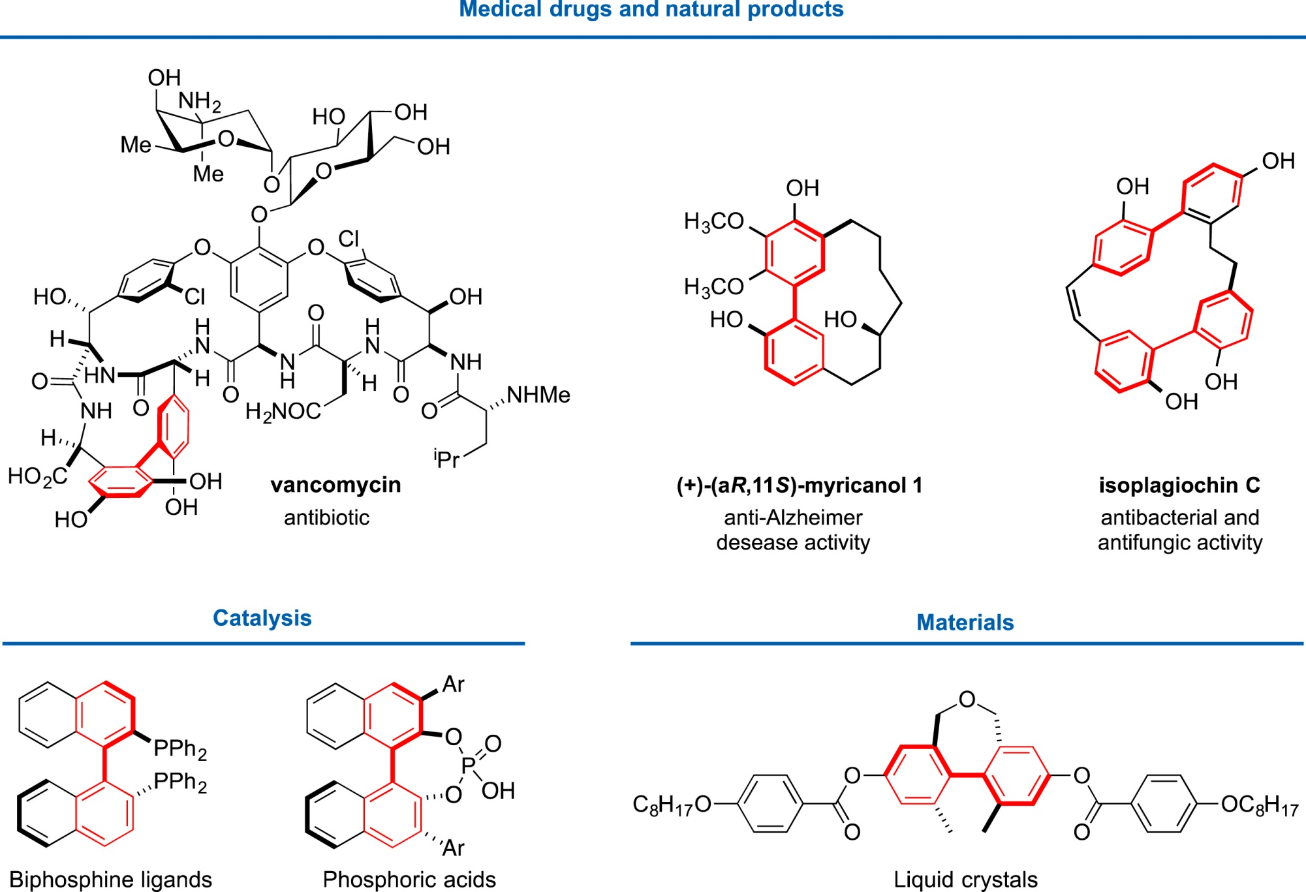
Many Important Molecules Exhibit Atropisomerism

Slide 30
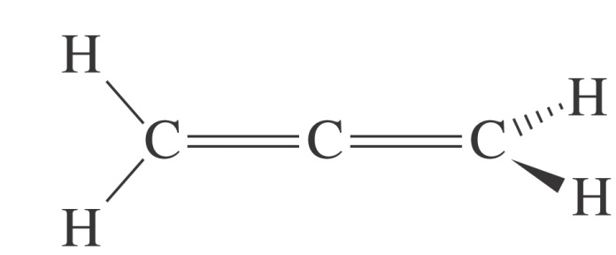
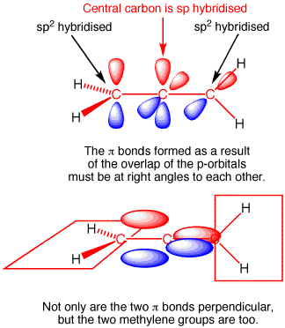
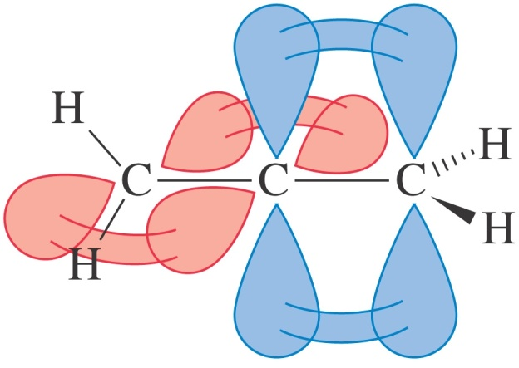
Axial Chirality in Allenes
Allenes are compounds which have two cumulative double bonds (two double bonds adjacent to each other).
The simplest allene is 1,2-propadiene.
The terminal carbon atoms are sp² hybridized while the central carbon atom is sp hybridized.
The bonding dictates that the two π-bonds be in perpendicular planes.

Slide 31
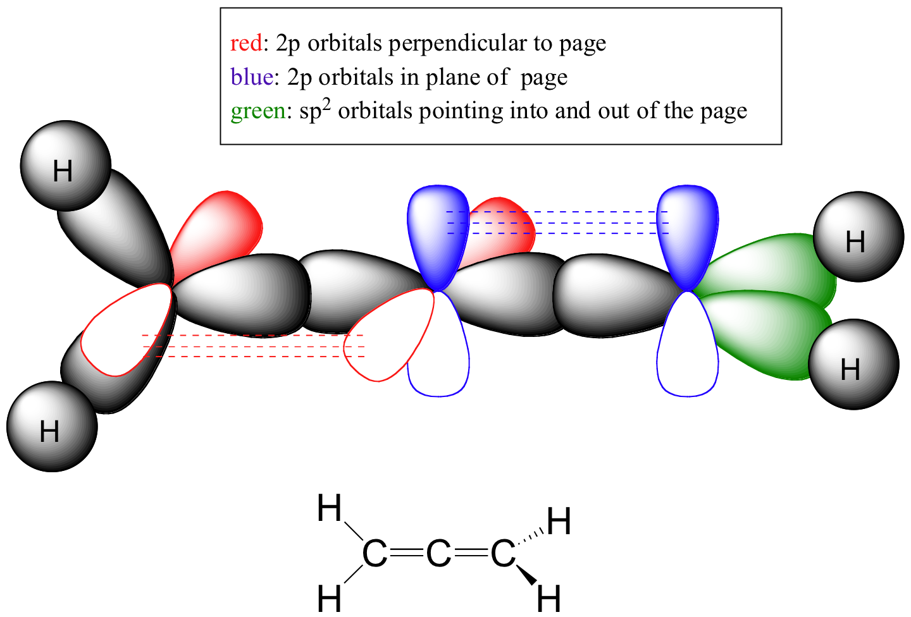
Bonding in Allenes

Slide 32
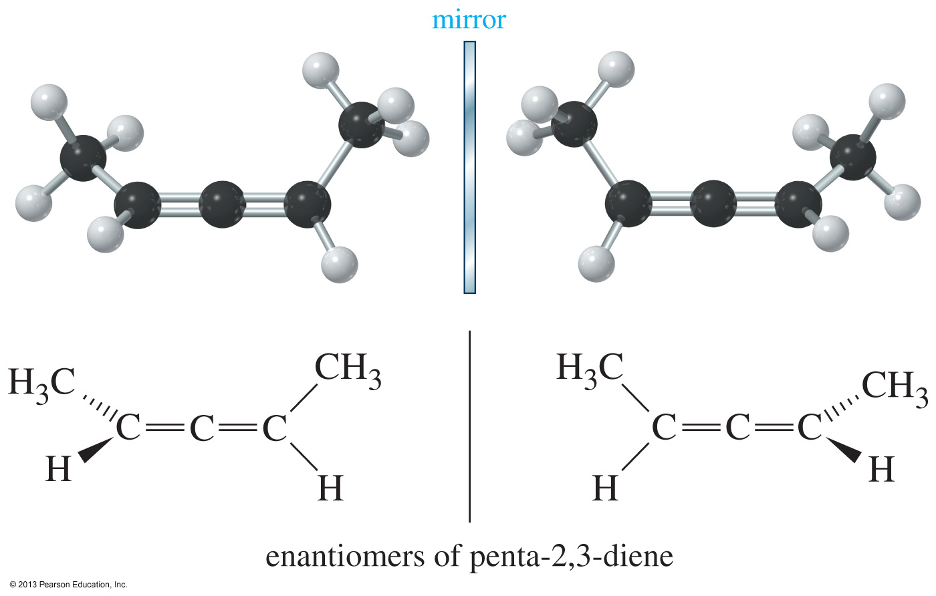
Chirality in Allenes
If the two substituents on the terminal carbon atoms are distinct, then the allene is chiral.

Slide 33
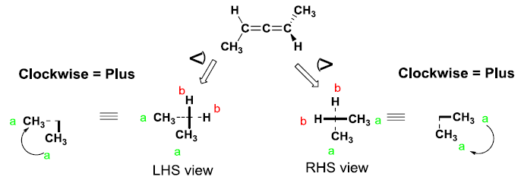
Chirality in Allenes
The “P” and “M” nomenclature applies to allenes as well.
Using the same procedure that we followed for biaryls, the configuration of allenes can be determined.
P
P

